Slide 1
You Must Remember This: Gendered Conflicts and Stereotypes within Interactive Dramas
Renee Ann Drouin Bowling Green State University

Slide 2


Interactive Drama
Priority of games as a narrative
Player choice/agency dictated
Primarily movement and conversation based
Often quick-time action set pieces
Studios like Telltale Games, Quantic Dream

Slide 3
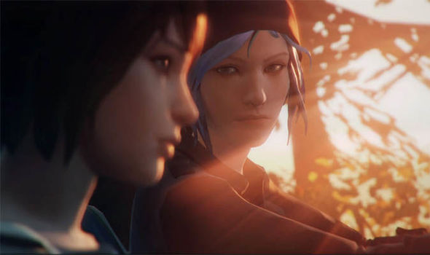
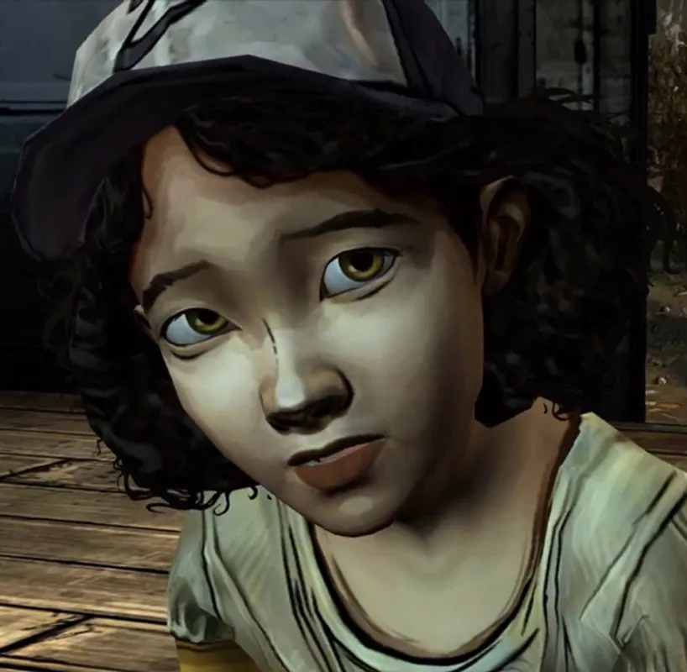
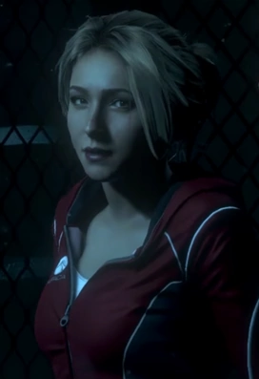
We Got Good Women!!!
Max (left) and Chloe, Life is Strange

Slide 4
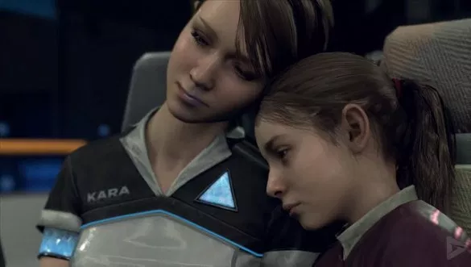
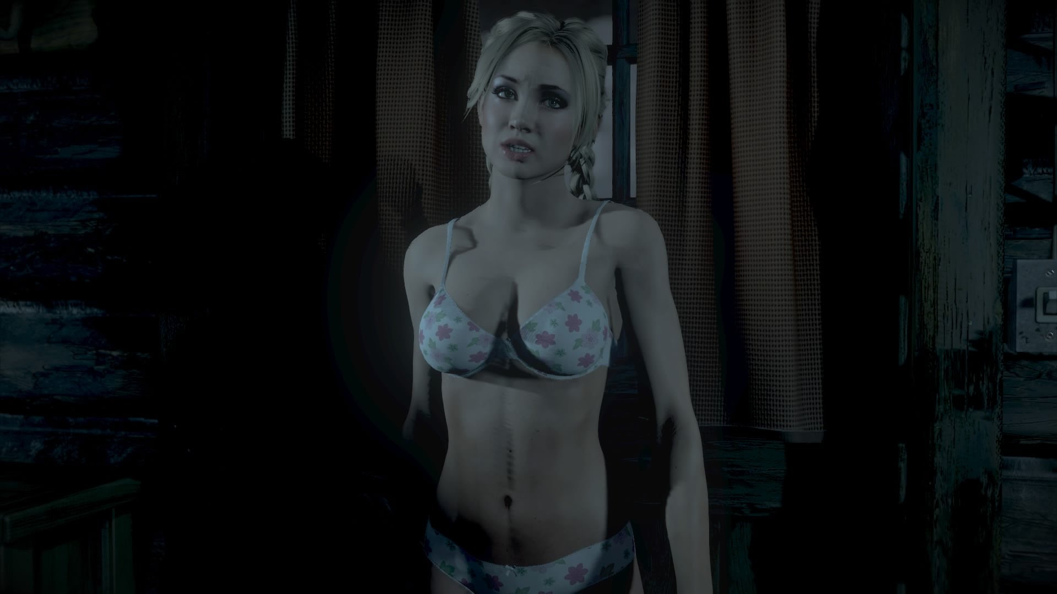
We…got problems even with good women
Silenced
Stereotyped
Sexualized
Suffering
Left, Kara and Alice of Detroit: Become Human
Right, Jessica of Until Dawn

Slide 5


Slide 6
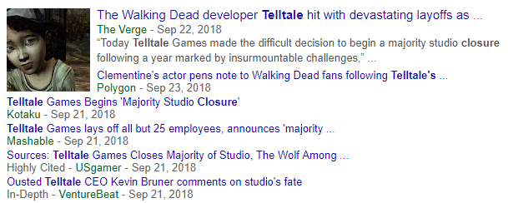
Telltale Closes

Slide 7
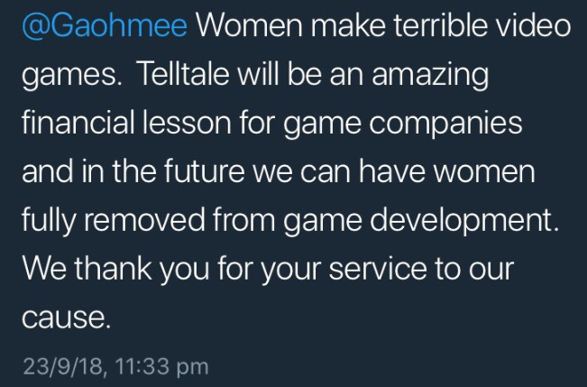
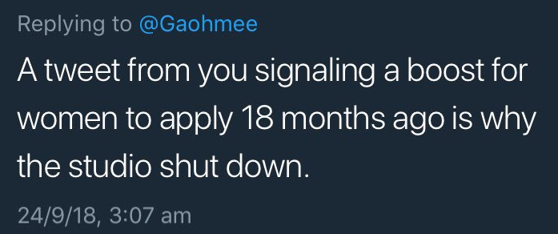
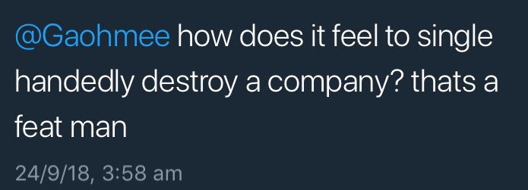
A Human Cost, and not just one I pay!

Slide 8
“While their legacy will include some great games, their legacy has to, now, inextricably, include the way it treated its workers. Cause that’s the story it leaves behind.”
Jim Sterling on Telltale’s Closure

Slide 9
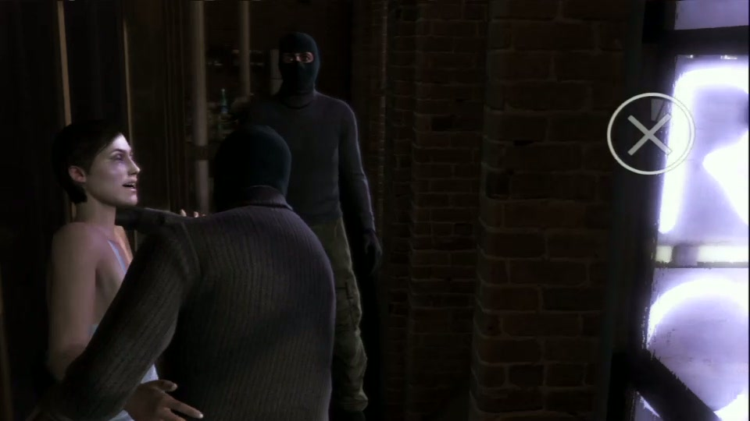
Four Points of Concern
Female Suffering
Female Sexualization/ Objectification
Female Silencing
Female Stereotyping

Slide 10
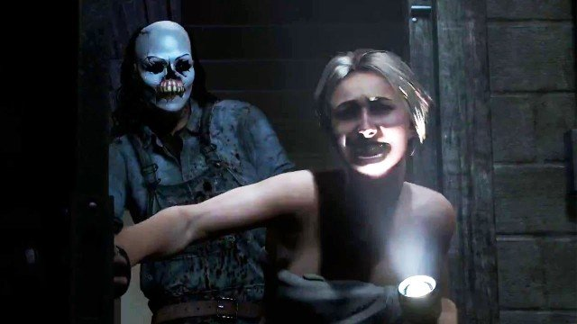
Reinventing The Wheel: Talking About Female Suffering/Sexualization in Popular Culture
Women in refrigerators (comics)
Women have suffered/been sexualized forever
Women more often partially nude (Downs and Smith (2010))
Men playing violent video games don’t empathize with female victims of assault (Gabbiadini (2016))

Slide 11

Without female suffering, these games cannot exist
Rachel Amber, Life is Strange

Slide 12
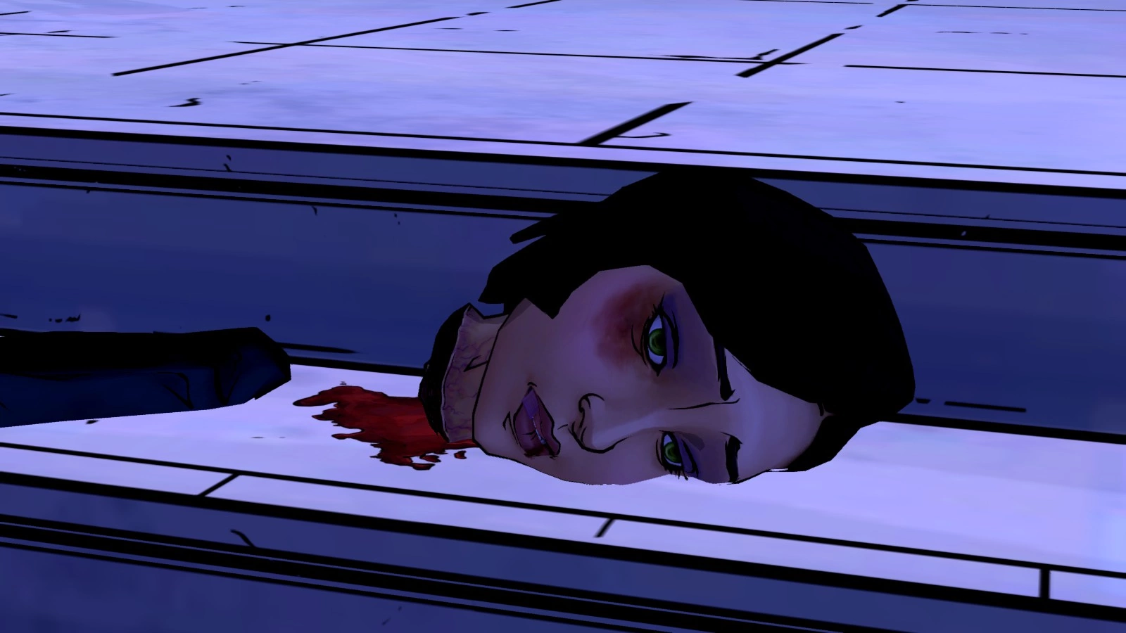
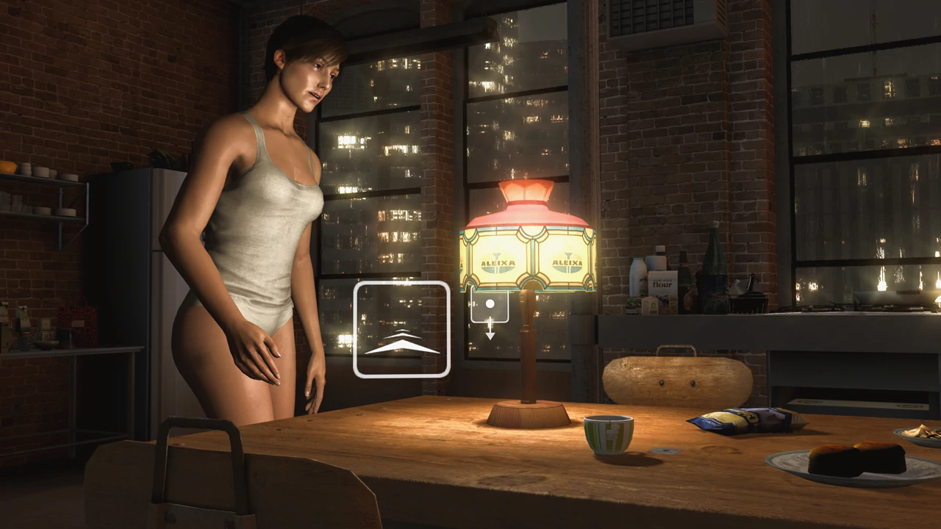
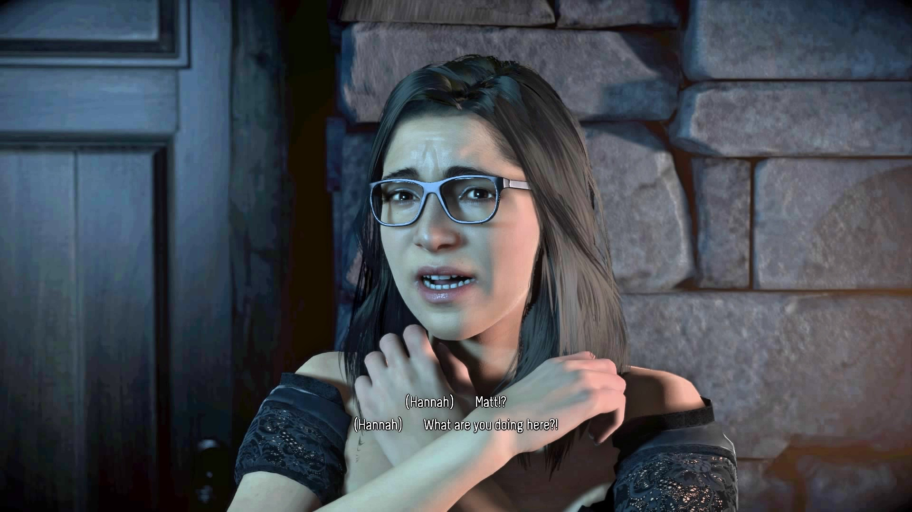
Interactive Drama Suffering + Sexualization
Perpetrated by men
Females punished for not saving other women
Women are the only ones who can’t be saved
Anything by Quantic Dream
  Women statistically killed most

Slide 13
The Supposed Great Equalizer
Life is Strange
  Women Suffering: Chloe, Max, Rachel Amber, Veronica, Kate, Joyce
  Most sexually assaulted or violated
  Uh that whole bury your gays thing
Heavy Rain
  A game about killing sons and the love of the father has more female death options then men
Detroit: Become Human
  Women easiest killed, cannot come back, women included just to die
The Walking Dead, Season One
  Lee murdered wife’s lover, Clementine’s parents killed/has to kill Lee, various women killed in narrative
Until Dawn
  Trick girl into sexual act, only ones you can’t save
  Grotesque sexualization of other teenagers
Beyond: Two Souls
  The entire game
The Wolf Among Us
  Killing multiple sex workers, sexualized surviving women
Oxenfree
  We kind of damn Alex and Clarissa to hell….like, a lot, also women are the ones lost in the void
Fahrenheit: Indigo Prophecy
  Agatha, Tiffany Harper, Indigo Child

Slide 14
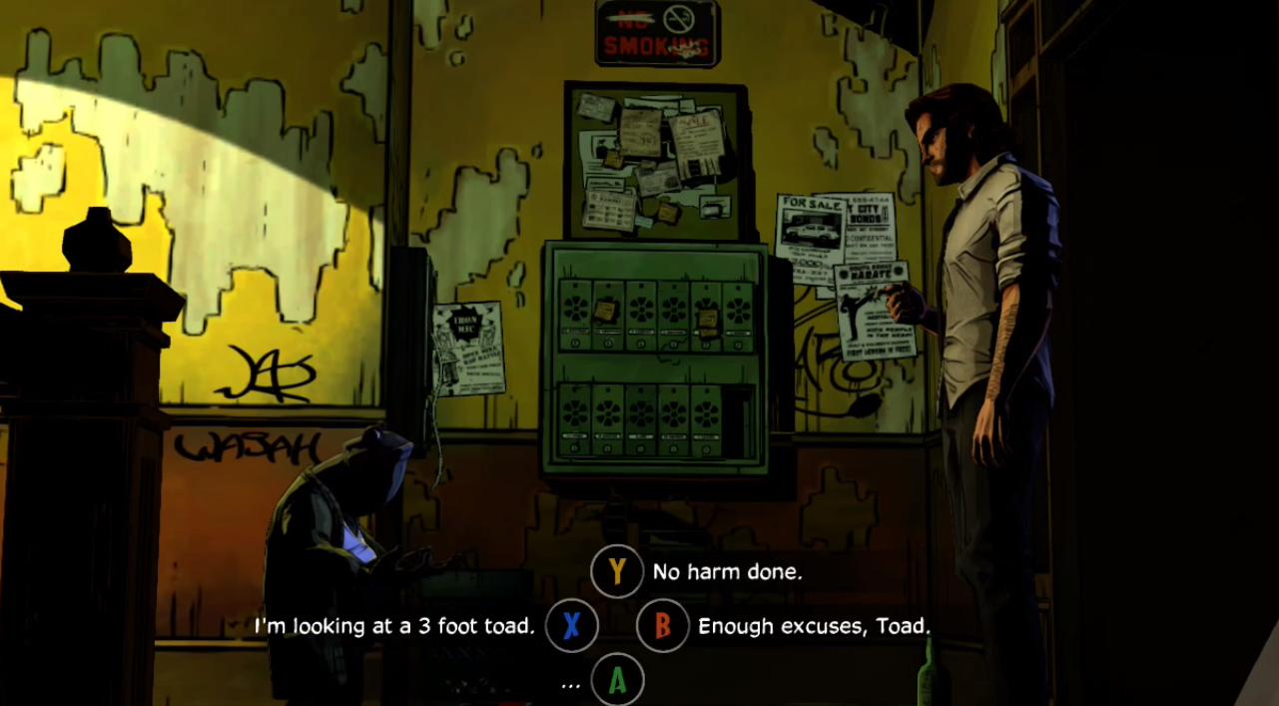
“The Strong, Silent Type” (Cheryl Glenn’s A Rhetoric of Silence)

Slide 15
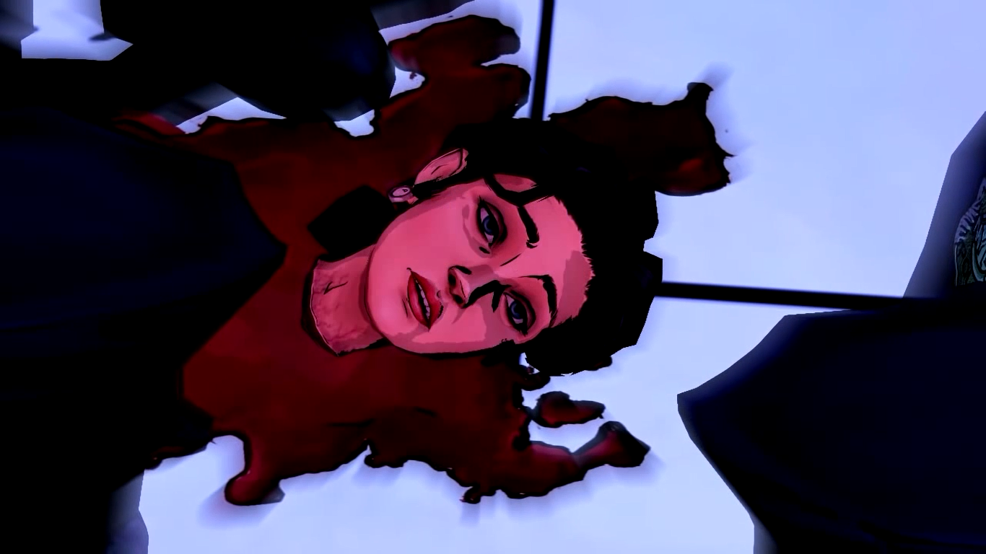
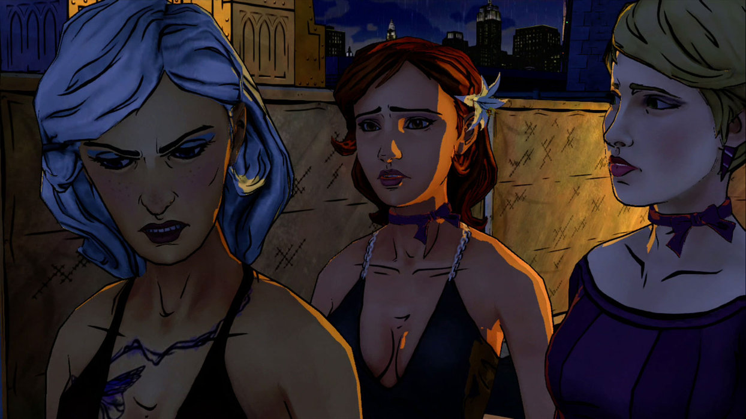
“My Lips are Sealed” The Wolf Among Us

Slide 16
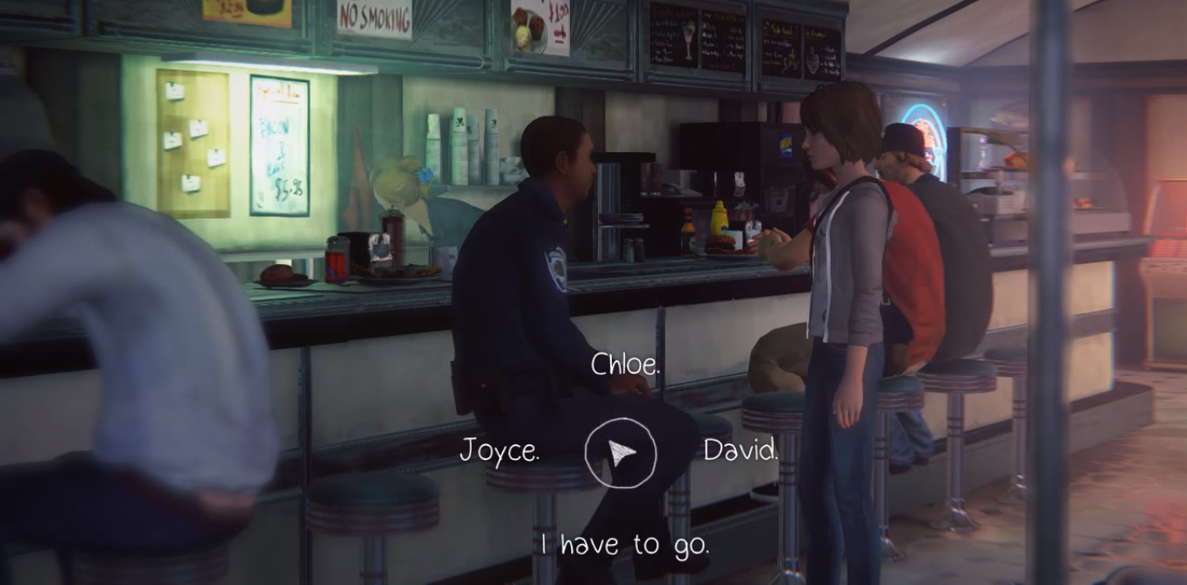
Speak Your Mind

Slide 17
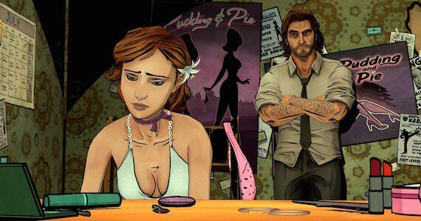

“Time to play the sexy girl!” Stereotypes and Other Reasons I Scream At Night
Love Interest (Madison Paige (Heavy Rain), Until Dawn Girls, Rachel Amber (Life is Strange), women of Fahrenheit: Indigo Prophecy)
Caretaker/Mother: Women of Heavy Rain, Kara (Detroit), Fahrenheit women, women in later seasons of The Walking Dead
Sex Worker: Detroit, Wolf Among Us, Heavy Rain, rumors of in Life is Strange
‘Object’

Slide 18

Detroit: Not Just a Race Problem

Slide 19

A Brief Case Study: Detroit: Become Human
One playable female (Kara)
  Goal: Be a mother to Alice
  Killed: If you’re not a good enough homemaker
Sex Workers
  Tracis
  North
    Love interest
Chloe
  Object to be killed

Slide 20
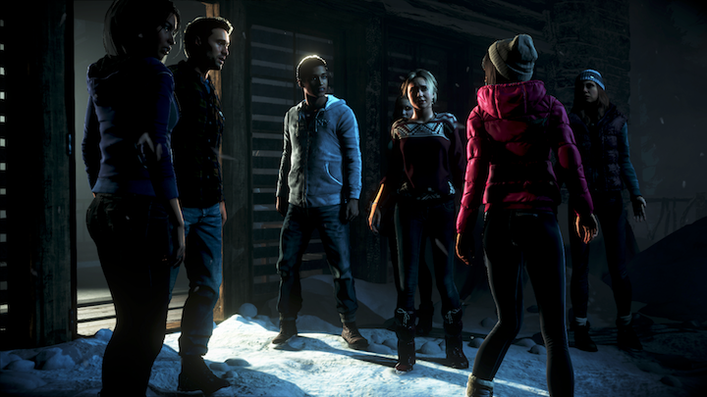
Conclusion (Is there one?)
Yay diversity?
Where do we go from here?

Slide 21
Works Cited
Beck, Victoria, and Chris Rose. "Is Sexual Objectification and Victimization of Females in Video Games Associated with Victim Blaming Or Victim Empathy?" Journal of Interpersonal Violence, 2018, pp. 886260518770187.
Downs E., Smith S. L. (2010). Keeping Abreast of Hypersexuality: A Video Game Character Content Analysis. Sex Roles, 62, 721-733.

