Slide 1
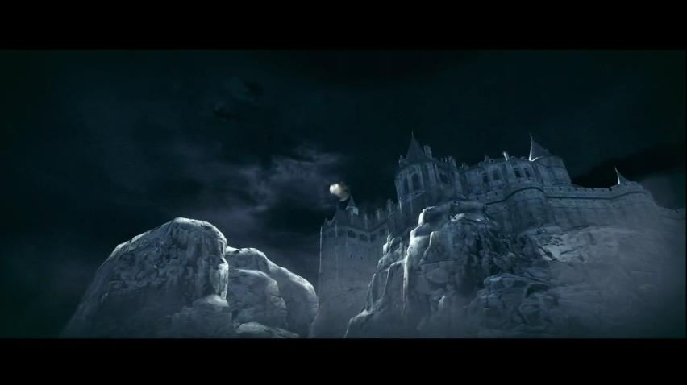
Domestic Battles and Mutilated Mothers: Gendered Conflicts of Resident Evil’s Experimentation
Renee Ann Drouin drouinr@bgsu.edu

Slide 2
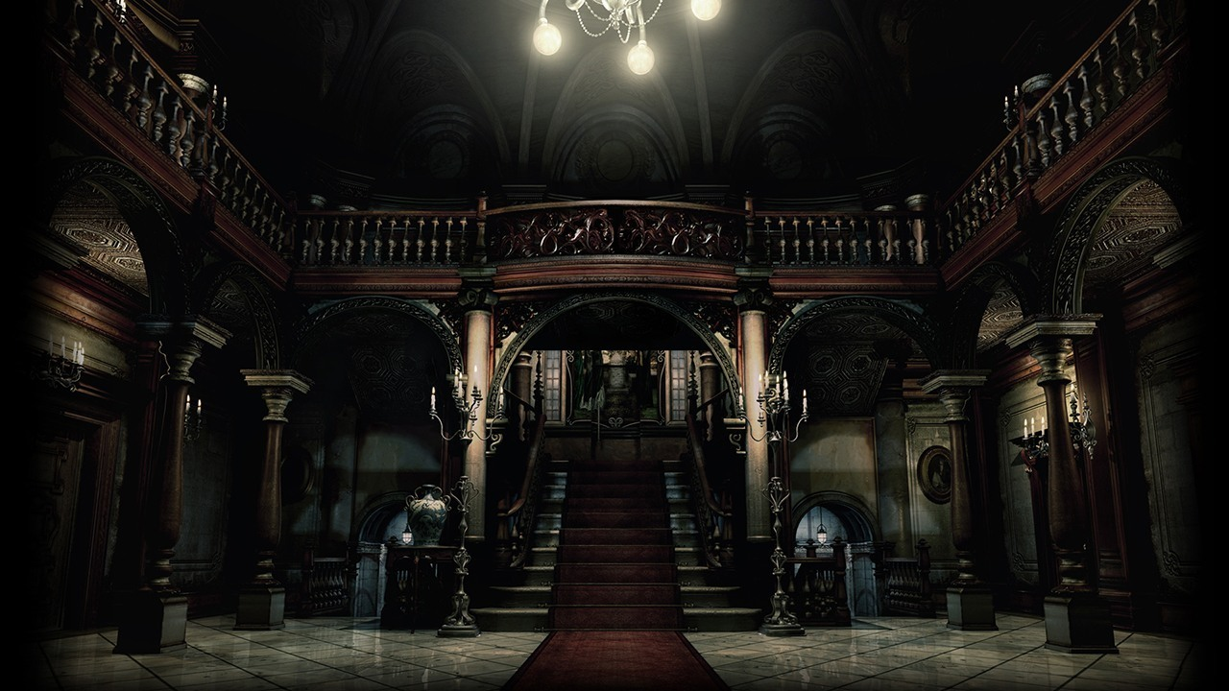
Try to get over my obsession with Resident Evil
Analyze how location and physicality impacts the killing efforts of villainous women

Slide 3
How feminist is survival horror?
The beginning of my nightmare

Slide 4
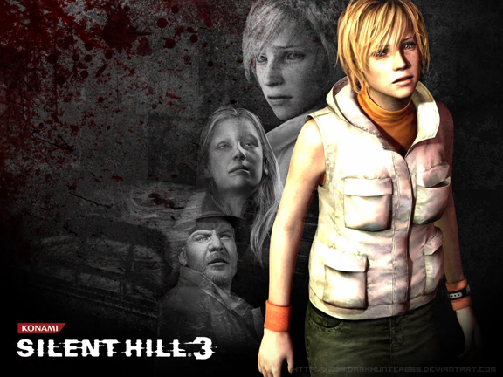
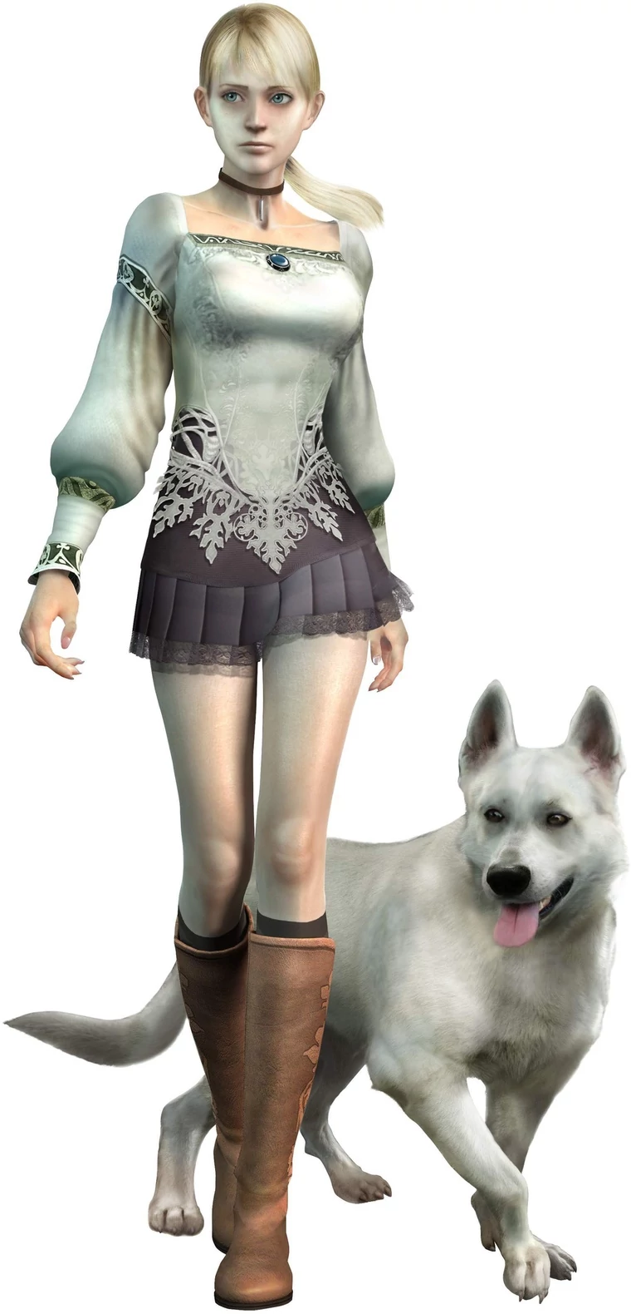
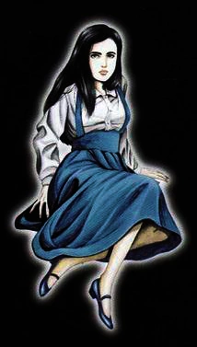
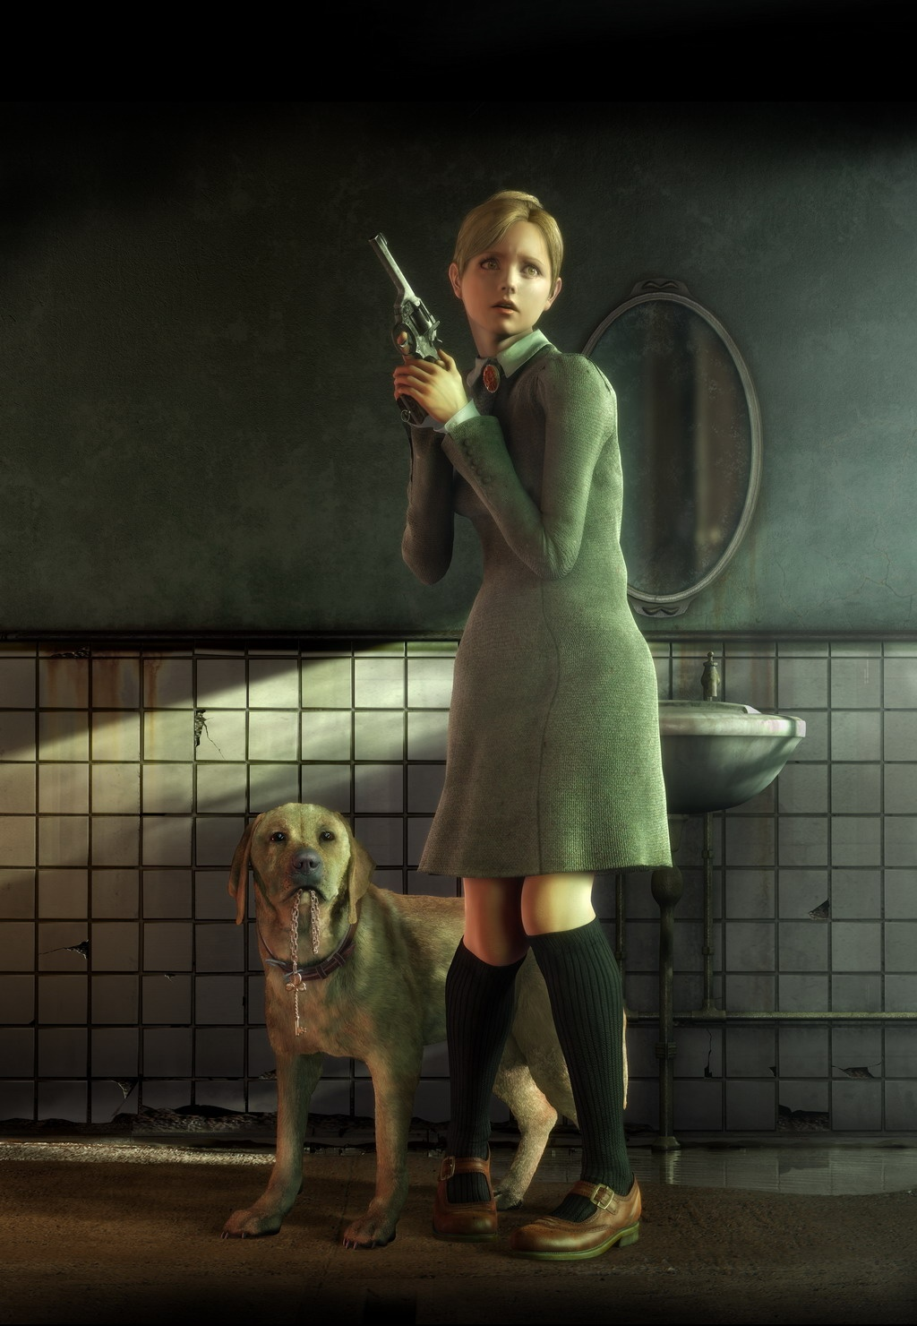
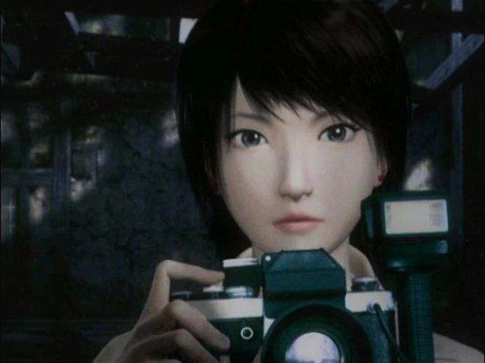
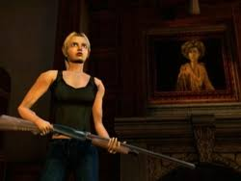
Women in Survival Horror (1990s-Mid 2000s)

Slide 5
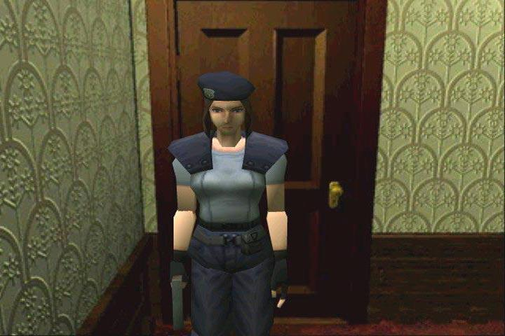
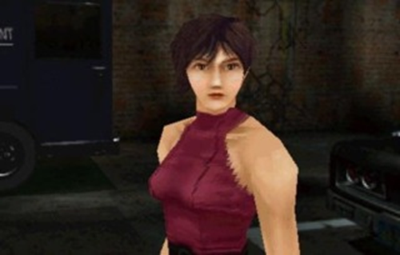
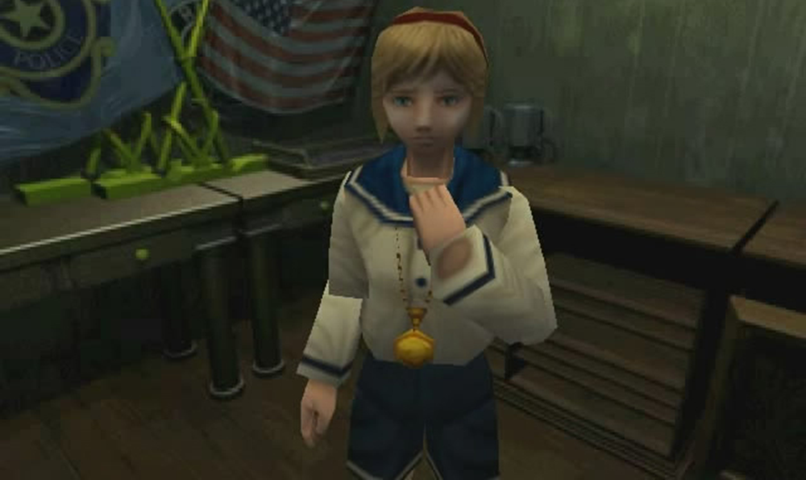
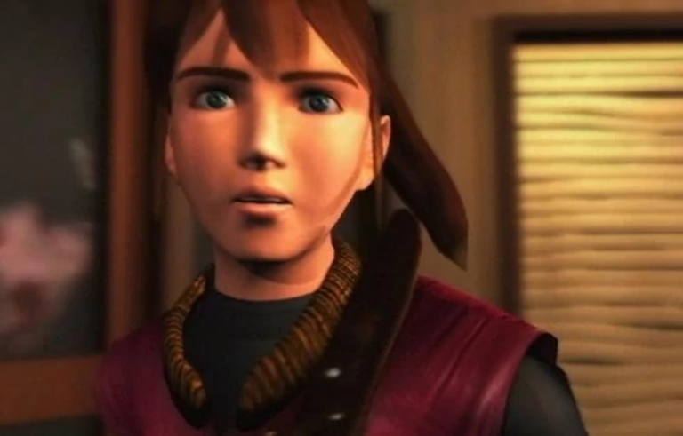
What is Resident Evil (1996-Present)?
Female leads, female narratives
  1996-2004
  Find your family
  Let men die for you
But what of villains?
Notes:
FIRST OF ITS KIND

Slide 6
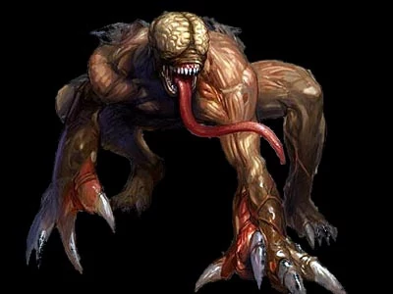
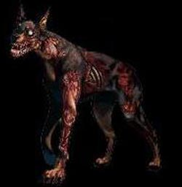
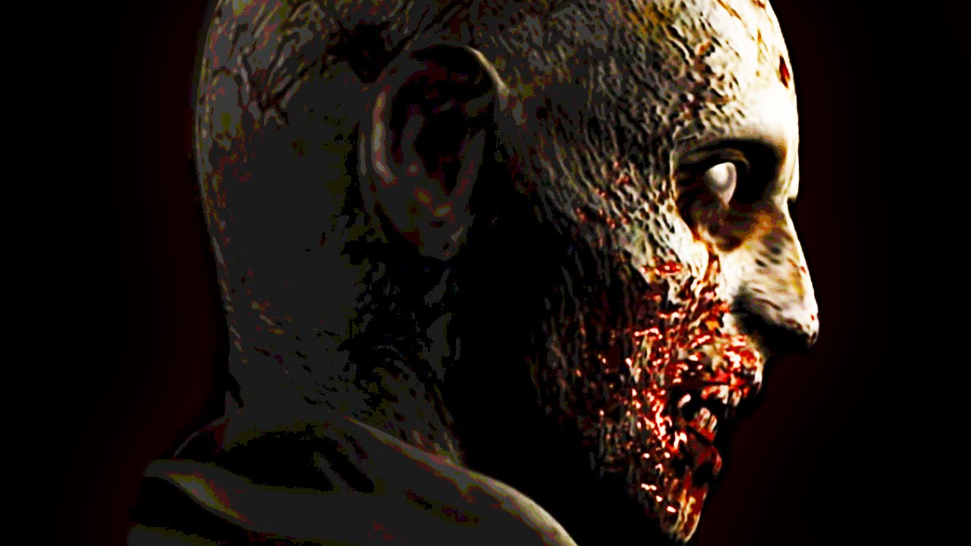
Bio Organic Weapons (BOWs)
Science is evil
Primarily male or animal
Female often plot related

Slide 7
How are female BOWs problematized?

Slide 8
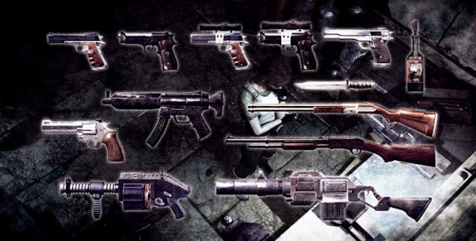
Domestic Rhetoric
Jordynn Jack ‘s “Acts of Institution: Embodying Feminist Rhetorical Methodologies in Space and Time”
Question Aspects of Gender = Better Understand Gender Differences
The "public, masculine universe" and "private, female worlds"
Resident Evil

Slide 9
Kill Like a Girl
Central Claims:
  Location matters
  Female monsters are spectacles

Slide 10
Domestic Barriers
Female BOWs are never killed inside the domestic, their protective space.

Slide 11
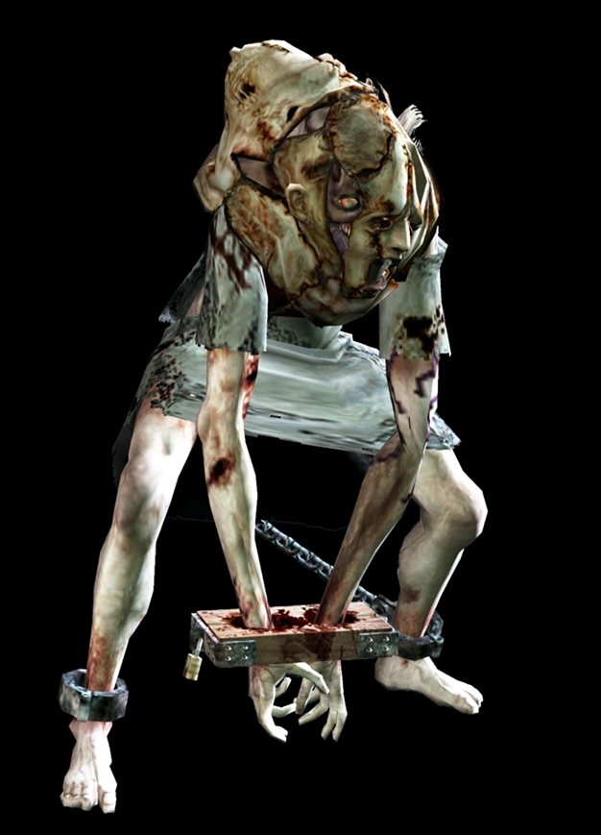
Lisa Trevor (2002, originally conceived 1996)
Only non-male BOW
  Women aren’t STEM
“Created” in the house
Cannot be killed by player

Slide 12
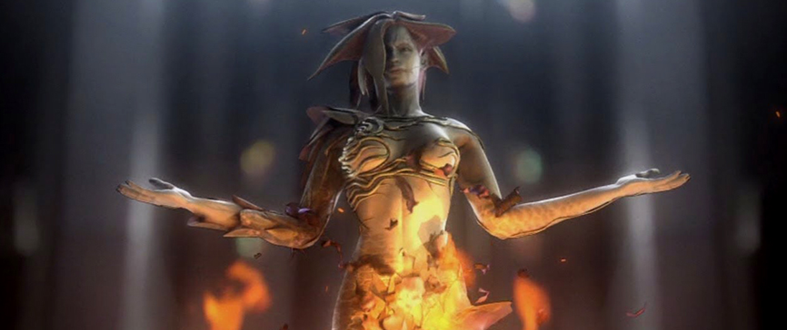
Alexia Ashford (2000)
Only non-male BOW
Cannot be killed by the player in the domestic
Killed in lab

Slide 13
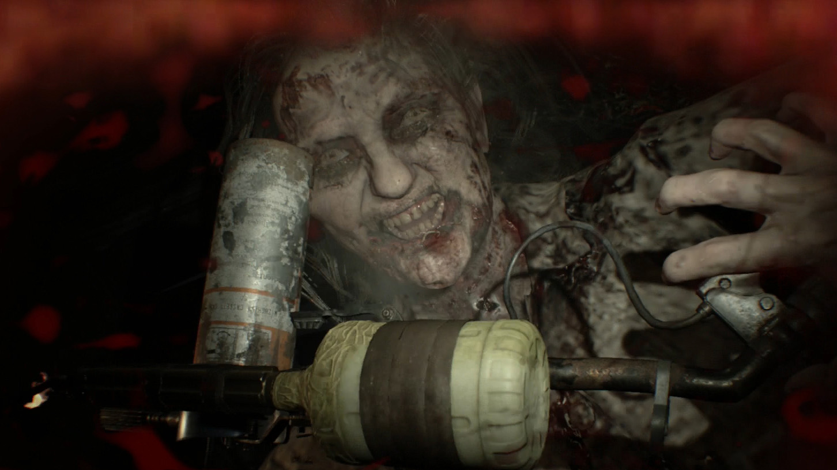
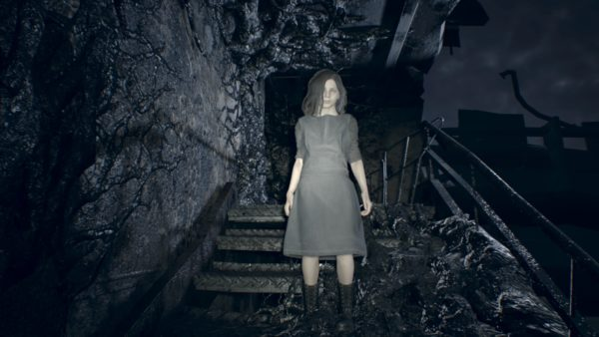
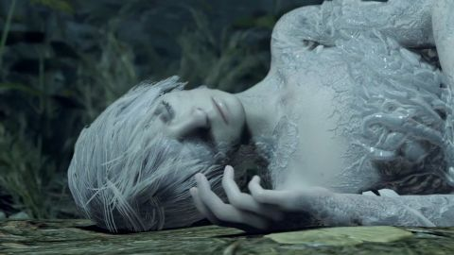
Monsters of Resident Evil 7 (2017)
Cannot be killed by the player within the domestic
  Die if removed
  Revived if returned

Slide 14
Places Male BOWs Thrive (especially plot relevant ones)
Anywhere that isn’t the domestic
  Streets of abandoned cities
  Across numerous countries
  Planes, Trains, and Automobiles
  Secret labs
Punished for occupying a private female space

Slide 15
Male Counterparts
“If forced to interact with the domestic realm, they flee it as soon as possible to focus on global concerns (i.e. terrorizing the planet, destabilizing governments, etc.) There is no preoccupation with the family but rather the need to abandon all tapestries of it.

Slide 16
Sexualized Monsters
To defeat female BOWs, players are required to sexualize them and mutilate their genitals.

Slide 17
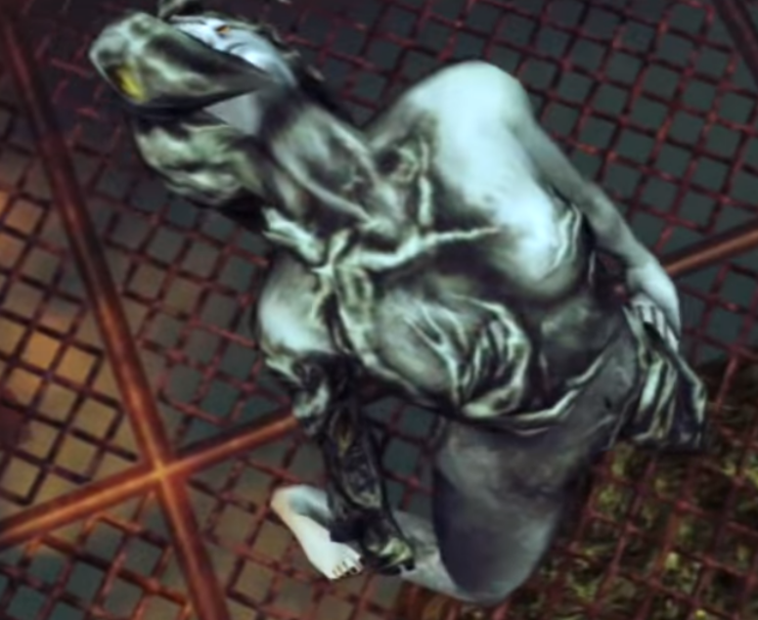
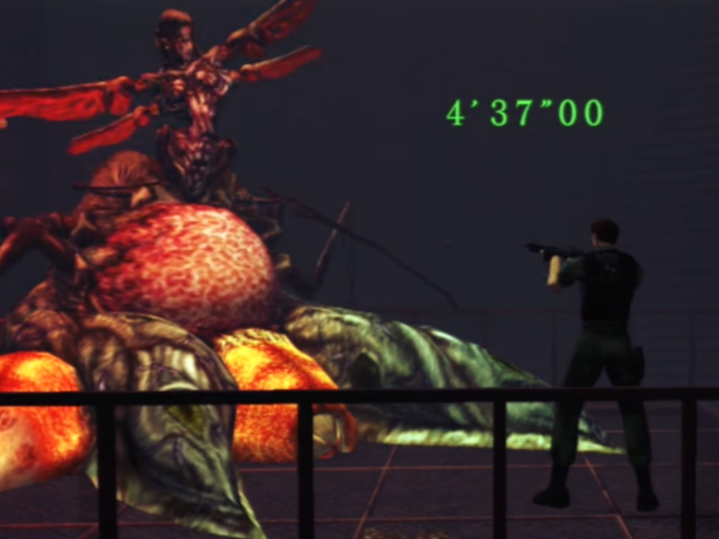
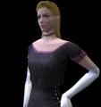
Alexia Ashford

Slide 18
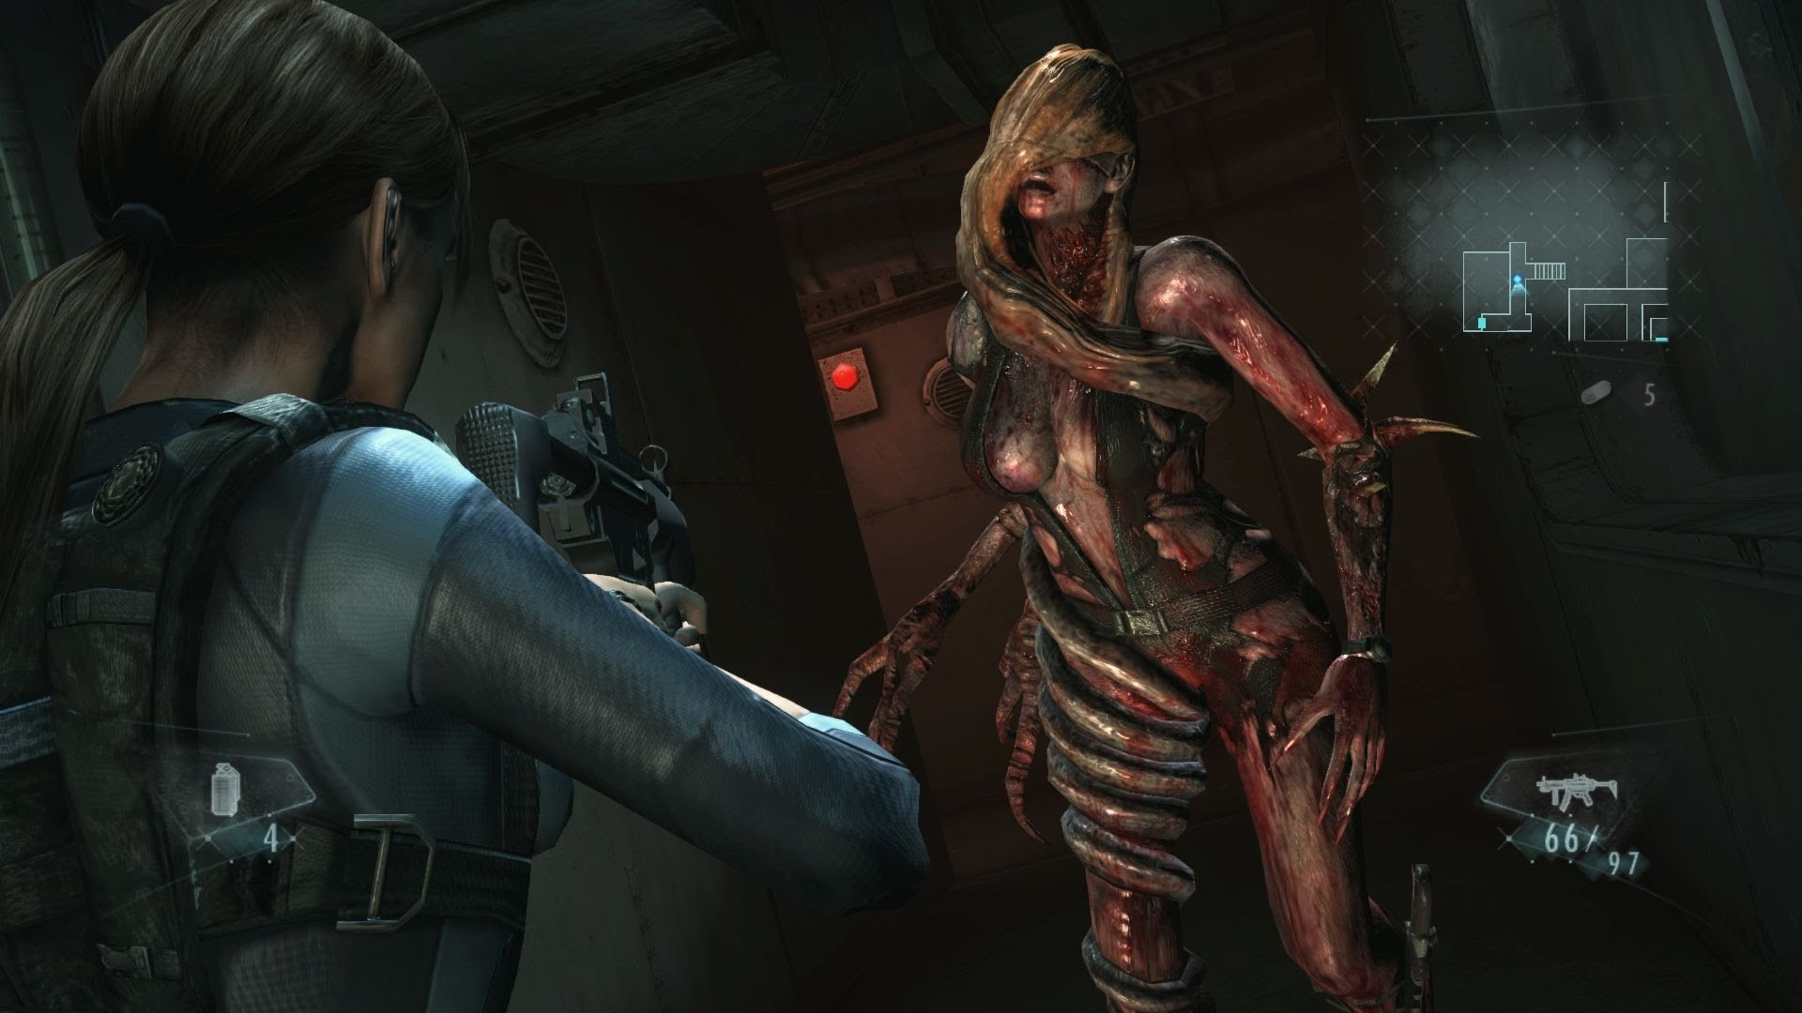
Rachel Foley (2011)

Slide 19
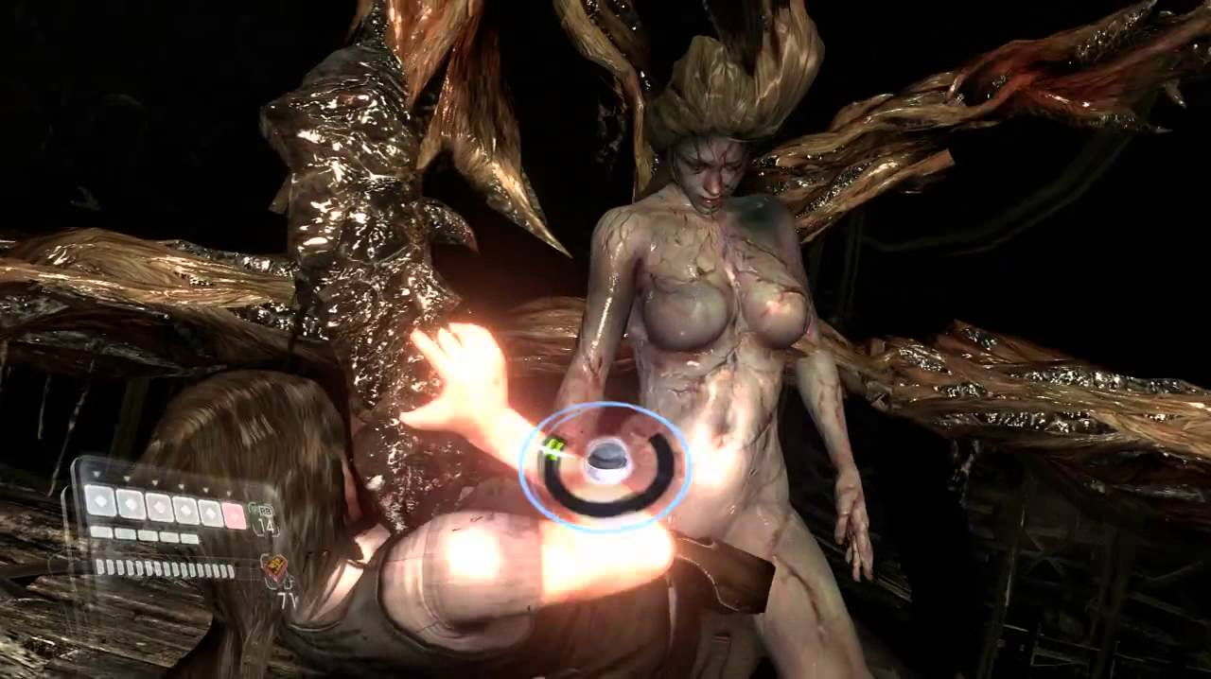
Deborah Harper (2012),
Deborah Harper (2012)

Slide 20
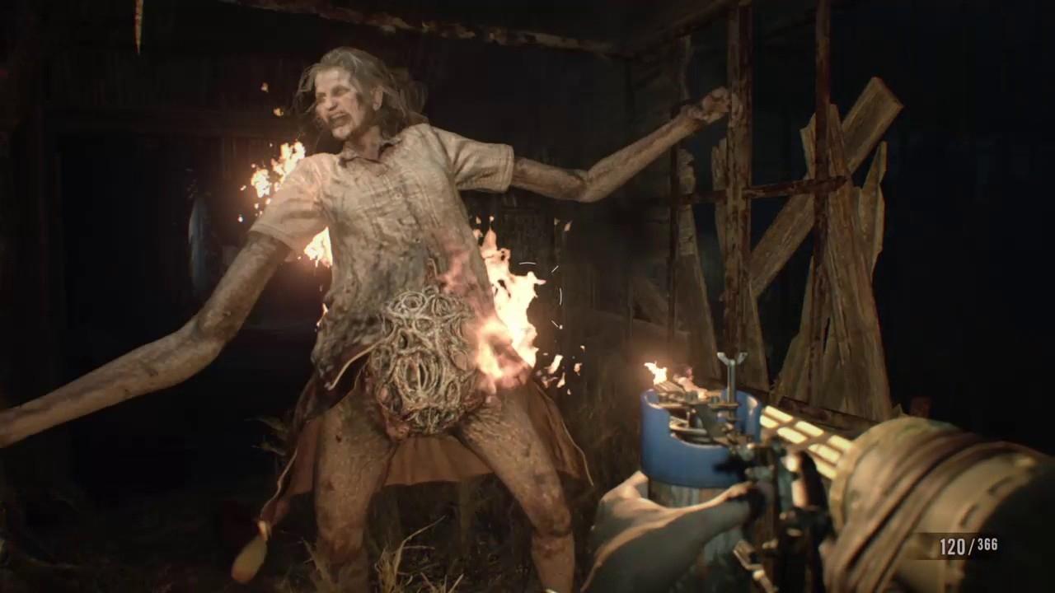
Marguerite Baker (2017)

Slide 21
And male BOWs?

Slide 22
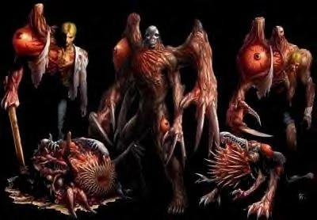
William Birkin (1998)

Slide 23
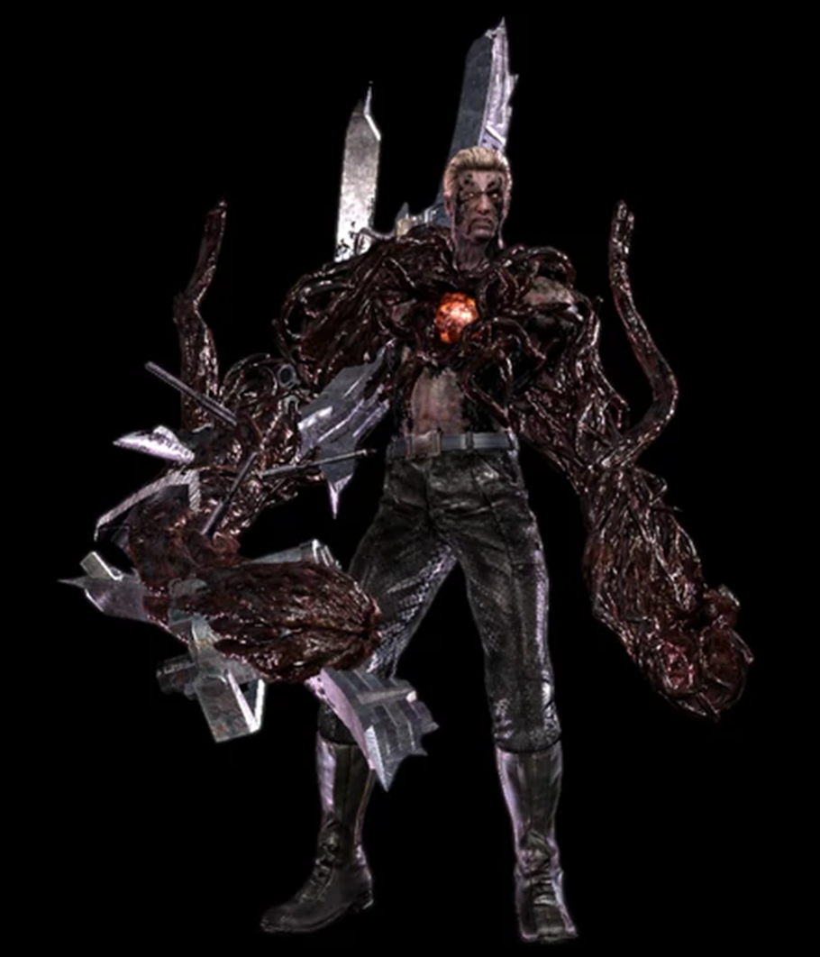
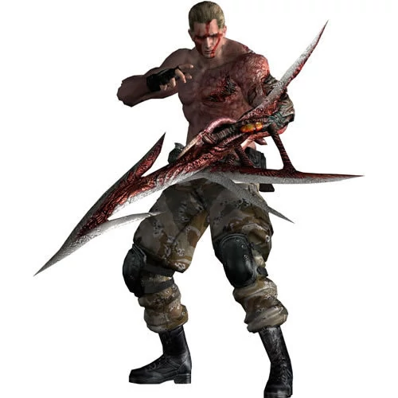
Albert Wesker (2009)
Jack Krauser (2004)

Slide 24
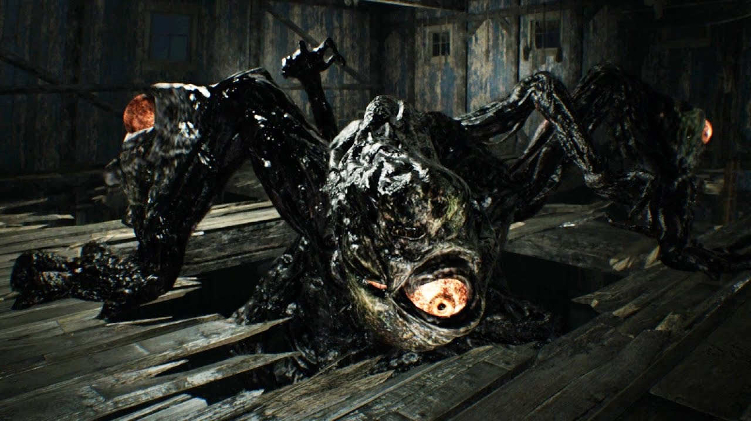
Jack Baker (2017)

Slide 25
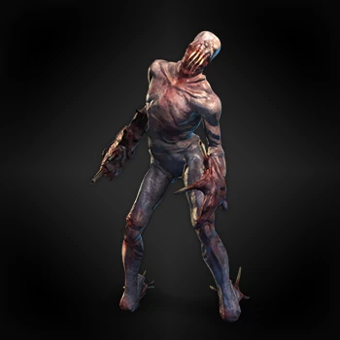
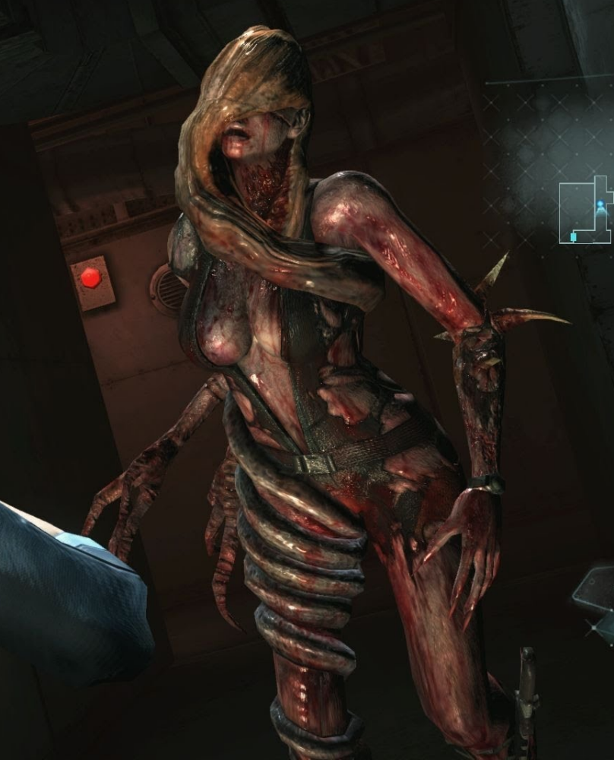

Slide 26
A lot of games sexualize female characters
Normalizing the sexualized brutality against women
Prioritizing a diverse male experience
  Male BOWs transform repeatedly
  Are not one shape

Slide 27
In Conclusion
Further discussions of rhetoric and studies of locations in gaming and its influence on gender
How our genres and series have progressed
Please stop making DLC for Resident Evil 7

Slide 28
References
Jack, Jordynn. "Acts of Institution: Embodying Feminist Rhetorical Methodologies in Space and Time." Rhetoric Review 28.3 (2009)
Reed, Charley. "Resident Evil's Rhetoric: The Communication Of Corruption In Survival Horror Video Games." Games And Culture 11.6 (2016)
Resident Evil Code: Veronica X. Capcom, 2001. Playstation 2.
Resident Evil: Director's Cut Dual Shock Ver. Capcom, 1998. Playstation 3.
Resident Evil HD Remaster. Capcom, 2015. Playstation 3.
Resident Evil: Revelations. Capcom, 2012. Nintendo 3DS.
Resident Evil Revelations 2. Capcom, 2015. Playstation 3.
Resident Evil Zero HD Remaster. Capcom, 2016. Playstation 3.
Resident Evil 2: Dual Shock Ver. Capcom, 1998. Playstation 3.
Resident Evil 3: Nemesis. Capcom, 1999. Playstation 3.
Resident Evil 4. Capcom, 2005. Playstation 2.
Resident Evil 5: Gold Edition. Capcom, 2010. Playstation 3.
Resident Evil 6. Capcom, 2012. Playstation 3.
Resident Evil 7. Capcom, 2017. Playstation 4.
Royster, Jacqueline Jones, and Gesa E. Kirsch. Feminist Rhetorical Practices: New Horizons for Rhetoric, Composition, and Literacy Studies. Carbondale, Southern Illinois University Press, 2012. Print.
Stewart, Kevin. "The Zombie Aesthetic and the Post-Apocalyptic Franchise." Kinema, no. 27, Spring 2007, pp. 27-42. EBSCOhost.

