Slide 1

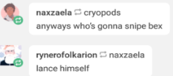
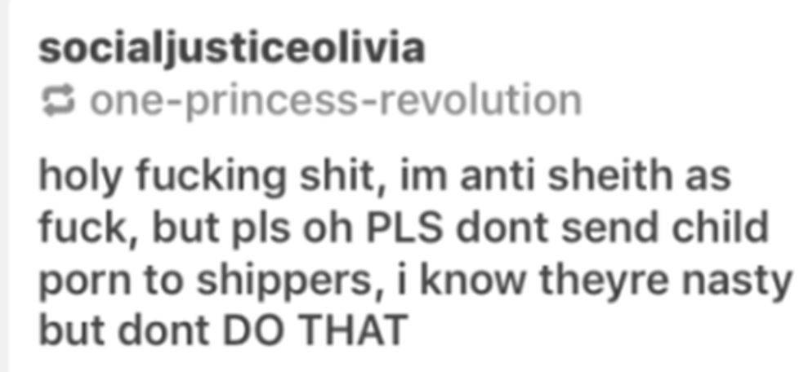
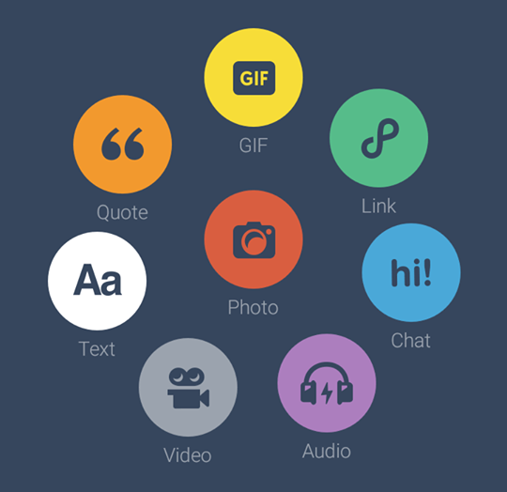
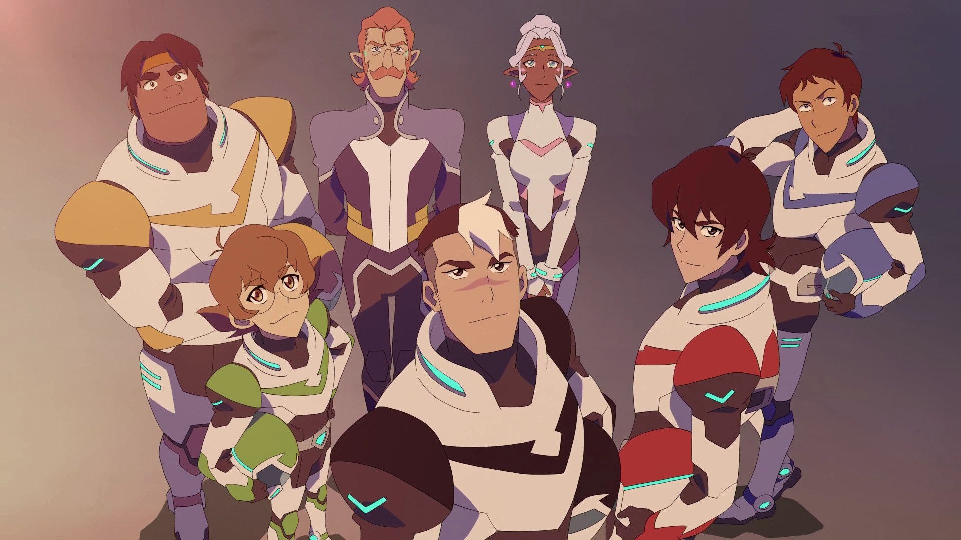
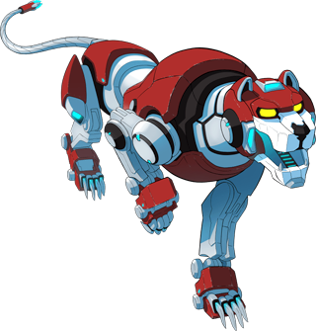
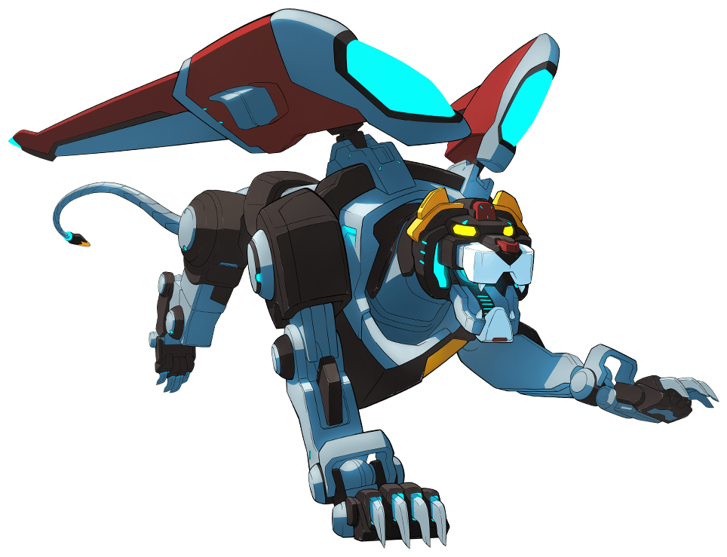
“Fans are going to see it any way they want”: An Ethnography of Harassment in the Voltron: Legendary Defender Fan Community
Renee Ann Drouin, with continuous regrets
Introduction
Writing studies has frequently ignored female harassment in online spaces. The precious little commentary about it, however, is focused on male harassment of women. Subsequently, my analysis of the female and queer fandom of prolific writers for Voltron: Legendary Defender on the Tumblr social media platform is atypical. By discussing digital ethics and gendered writing harassment, I will blend numerous fields not often held in conversation with each other, such as fandom, digital ethics, rhetoric, and social media writing. A secondary goal in documenting such harassment is to highlight and offer reflection on the writing our students are doing and dangers we inadvertedly put them through in a quest to diversify our embodied writing locations.
Methods
Utilizing a mixed methods approach, I will use qualitative ethnographic tools to analyze the community and quantitative coding to recognize rhetorical patterns and users. Complex questions of digital ethical ethnographies of ‘unaware’ groups mitigated by my position of a fan and group’s cultivation as reputation of wanting attention.
Literature Review
Collins and Cooper, 2014
Fahie, 2014
Greckhamer and Cilesiz, 2014
Miller, 2012
Mutula, 2011
Boydell, et. al, 2014
Costello, McDermott, Wallace, 2017
Palys and Atchison, 2012
Steinmetz, 2012
Qual Ethics Digital Methods
McCracken, 2017
Busse, 2015
Gerrard, 2018
Wick and Harringer, 2018
Waggoner, 2018
Herring, 1999
Jane, 2015
Lammers, 2016
Lumsden and Morgan, 2017
Magnifico, Curwood, Lammers 2015
Fandom
Rhetoric
Significance
Research indicates little scholarship has paid to ways women utilize harassment against other women. More importantly, this writing functions as self-sponsored digital writing that dictates our students’ attention. This fosters cognition in writing studies to the digital writing and spaces we’re advocating our students are using. Further, I argue the Voltron case study allows a potential framework for ethically performing qualitative research in fandom spaces.
Research Question
How do women write and utilize harassment in online spaces?
Timeline
Data Collection
Goal: Demonstrate the longevity of the harassment and the volume of users,
Sources: Comment sections of two years of Tumblr posts from “Fandom” an independent blog created by Tumblr that documents the trending topics of the website each week. Collections of Anti blogs, frequent targets, the tags of each main ‘ship’.
Rationale: Since Voltron’s inception, fans have used the comment sections to harass others about their opinions on the show.
Winter 2018/Spring 2019: Collect data of immediate reaction to the Voltron ending, consider blogs for additional research
Fall 2019: Begin coding for foundation of Prospectus.
Patterns of harassment, identifications of fans,
Commentary on tumblr & social media
Spring 2019/Summer 2019: First
three chapters (intro, method,
Coding)
Fall 2020: Finish
Defend
VLD : animated show of humans piloting robotic lions to save the galaxy. Certain fans latched onto the character Lance (far right) and abused others for not supporting their interpretation of a romantic relationship with Keith (red) and their desire to see Lance as the lead of the show.

